Slide 1
It’s Not Just Usability
Kristen Galloway

Slide 2
What is Usability?
The ease of use and learnability on a human-made object
The object of use can be a software application, website, book, machine, or basically anything a human interacts with

Slide 3
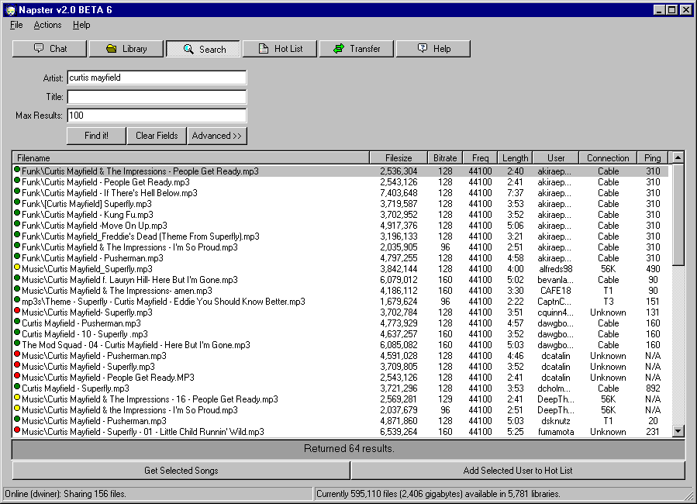
Is it THAT important?
Napster was the most popular software application in 1999 despite having a terrible UI

Slide 4
Is it THAT important?
Napster gained roughly 250,000 new users a week during its time (source)
What does that tell us?
  An application that does something great that people want doesn’t necessarily have to be easy to use
If something is easy to use but utterly useless, the application will flop
In a lot of cases, usability is optional

Slide 5
Is it THAT important?
Usability isn’t not important, it can make or break applications in some aspects
  40% of people will abandon a web page if it takes more than 4 seconds to load (source)
  48% of users say that if they arrive on a business site that isn’t working well, they take it as an indication as the business “simply not caring” (source)
There’s a next level in software design called “designing the social interface”

Slide 6
Social Interface
The Internet has brought all of us a new kind of software that’s about human-human interaction
It’s not all about human-computer interaction because newer software mediates between people
UI is still somewhat important here, but the social interface is more important

Slide 7
Examples
Failure
  Have you ever gotten an email asking you to join a social network?
  It’s because that software has went through an address book of a friend and sent an email to everyone
  It isn’t friendly, it’s automatic
  Human networks do not work this way

Slide 8
Examples
Success
  Texting!
  People are less shy and inhibited when typing rather than speaking face-to-face
  Texting UI’s are terrible but one of the most popular ways of communication
  Even though there’s a better UI installed on your phone that makes phone calls, people prefer stringing together words through buttons than just dialing a number and calling someone

Slide 9
Side Affects
Small changes in software can make drastic changes in the way software supports social goals
  Take for instance: people with autism
  Autism affects the way people learn procedurally
  This causes a lack in social and communication skills
  LinkedIn and Facebook are great examples of this, by formalizing how people construct and manage friendships

Slide 10
Designing Social Software
Suppose a user does something they shouldn’t have, like post an appropriate ad on a forum
  Good usability says to give them a smack on the hand and remove the post
  Social software frowns at this, because most users will just post another advertisement but tweak it so it will sneak by (ex. Replacing letters with numbers)

Slide 11
Designing Social Software
Sociology plays an important part in social interfaces
The goal of social interface design is to help society succeed, even if one user has to fail
Back to the inappropriate ad:
  In a good social interface, the ad would be “accepted”
  The user believes it was posted, feels smug, but the ad was never posted
  The best way to deflect attacks is to make them look successful
  About 95% affective

Slide 12
A New Field
This design is new but on its way to being as important as human-computer interaction
Over the new few years, anthropologists and ethnographers will be expected to work on this design
With their help, we hope to figure out a bit more about social interaction design

Slide 13
Conclusion
Usability is definitely important, but it’s not everything
In the world we live in, social interaction design is important because social media is growing every day
The best UI in the world won’t save you from an awkward moment through a social interface

Slide 14
Questions?

Slide 15
References
http://www.joelonsoftware.com/articles/NotJustUsability.html
http://www.kennedykrieger.org/potential-online/potential-fall-2004/missing-link
http://blog.marginmedia.com.au/Our-Blog/bid/87385/10-Mobile-Web-Design-Statistics-All-Marketers-Should-Know-About
https://econsultancy.com/blog/10936-site-speed-case-studies-tips-and-tools-for-improving-your-conversion-rate#i.q9egvh18zxdnvy
http://murphylibrary.uwlax.edu/digital/jur/2001/woelfel.pdf

